Slide 1
Rockbuster Stealth
Data Analysis
By Andrew Brock

Slide 2
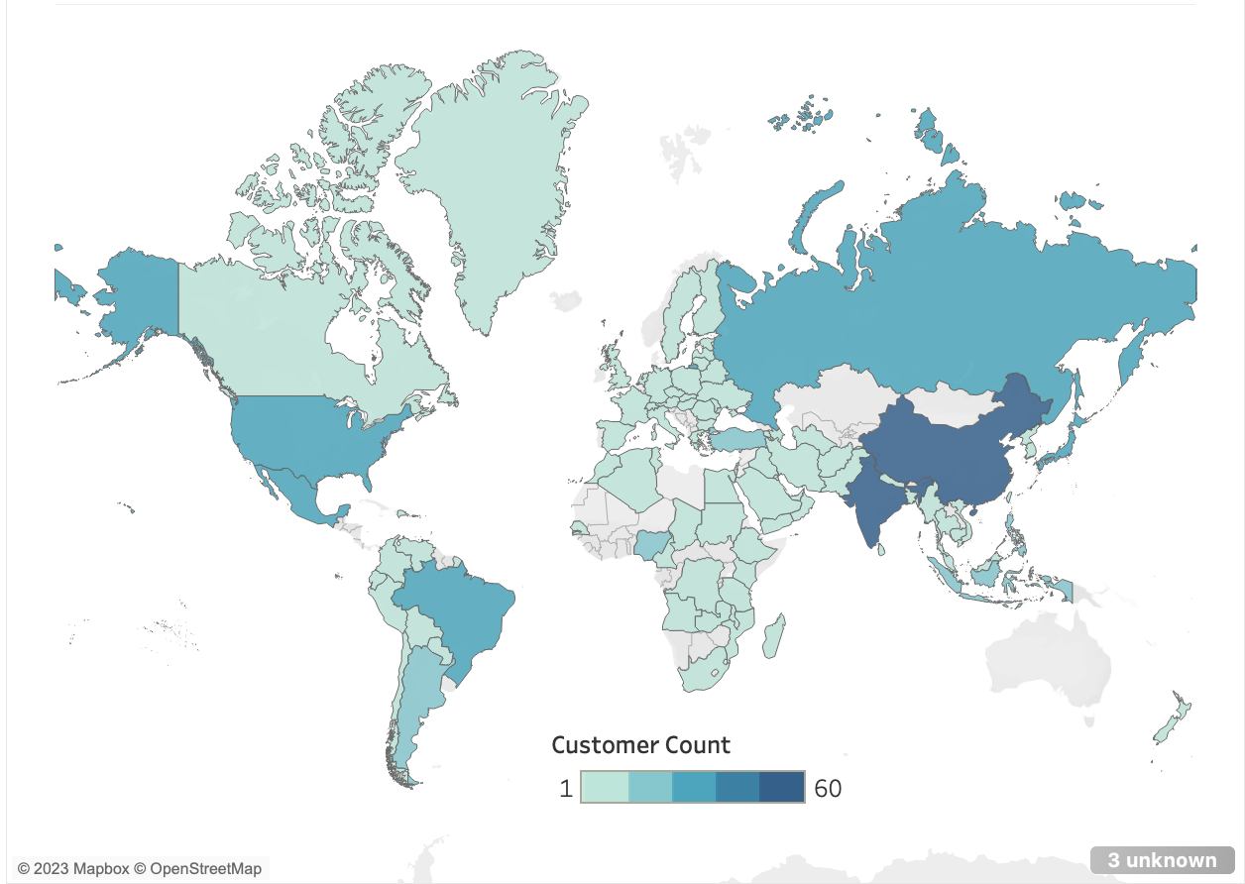
Rockbuster Customers

Slide 3
DESCRIPTIVE STATISTICS
Column | Min | Max | Average
Release_year | 2006 | 2006 | 2006
Rental_duration | 3 days | 7 days | 5 days
Rental_rate | $0.99 | $4.99 | $2.98
Length | 46 mins. | 185 mins. | 115.27 mins.
Replacement_cost | $9.99 | $29.99 | $19.98

Slide 4
MORE DESCRIPTIVE STATISTICS
Column | Mode
Title | Academy Dinosaur
Language_id | 1
Rating | PG-13
Last_update | 2013-05-26 14:50:58.951
Special_features | {Trailers, Commentaries, ”Behind the Scenes”}

Slide 5
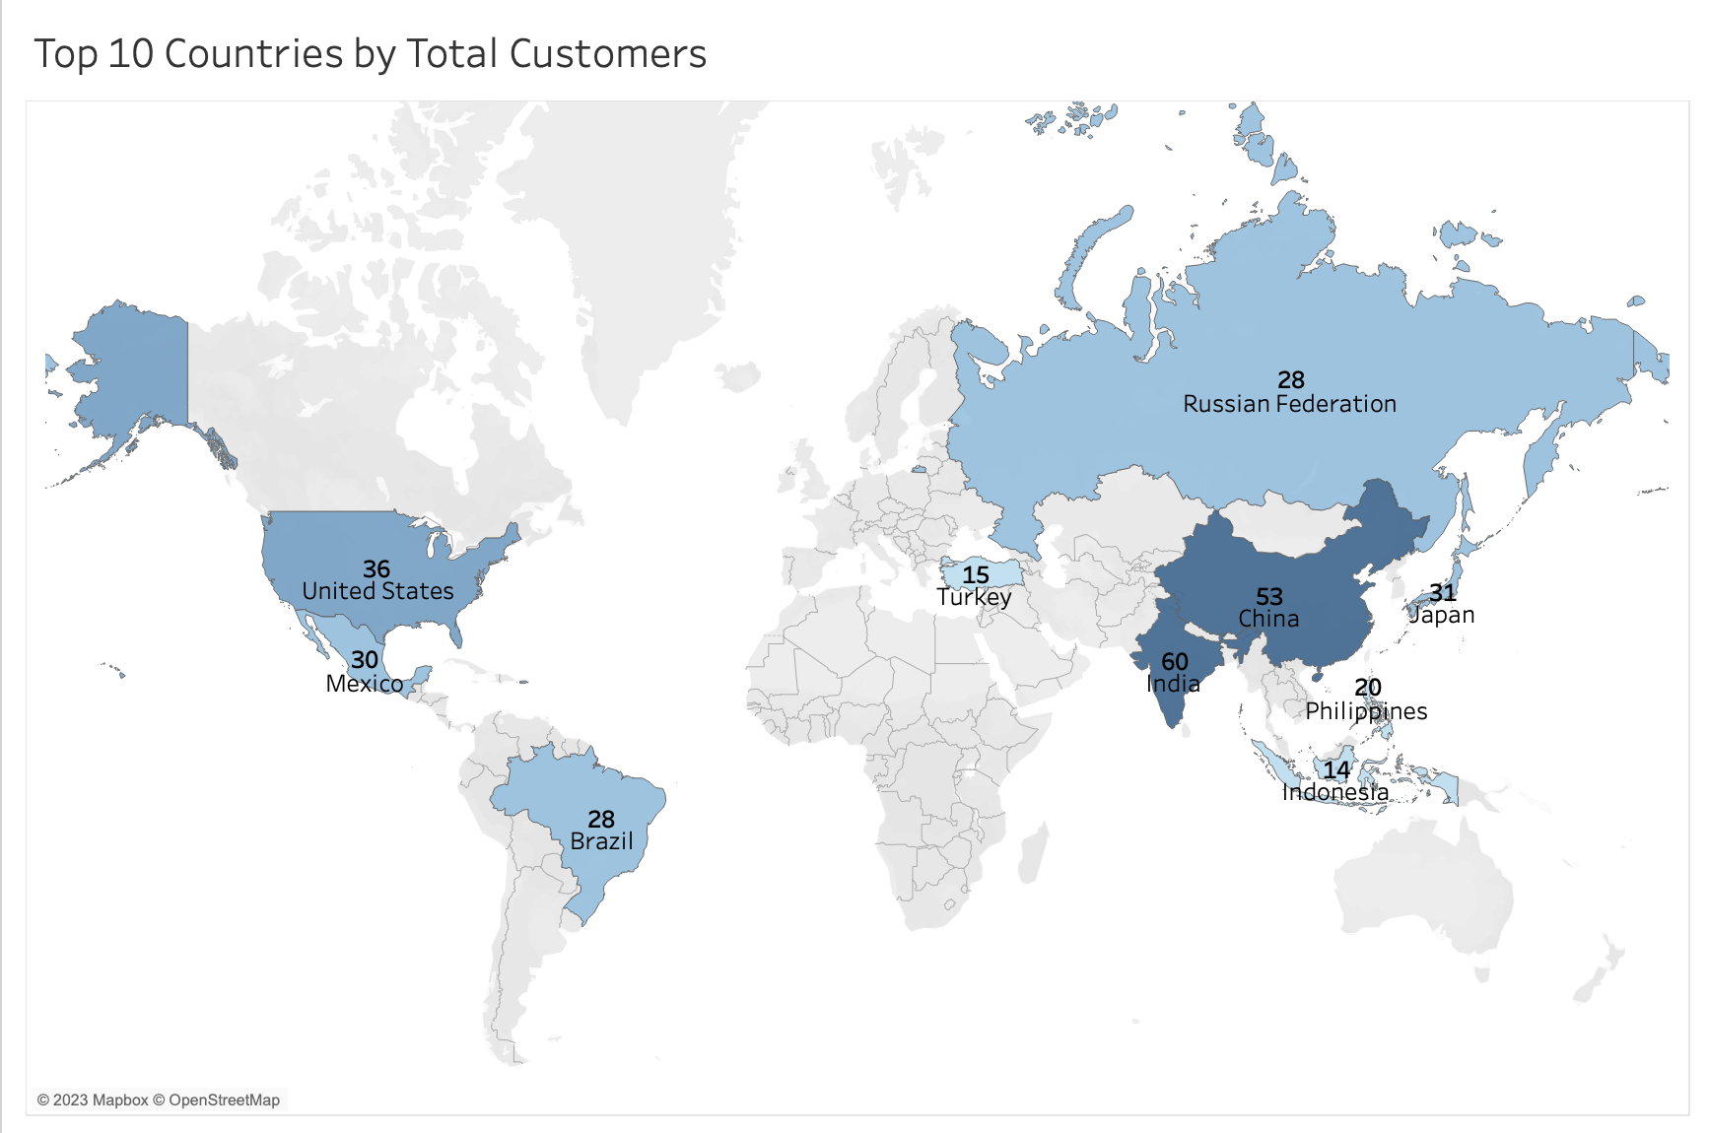
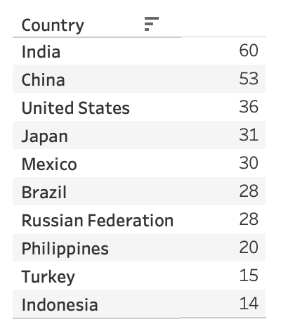

Slide 6
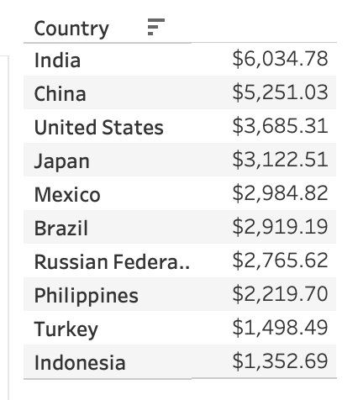
Top 10 Countries by Customers and High Lifetime Value

Slide 7
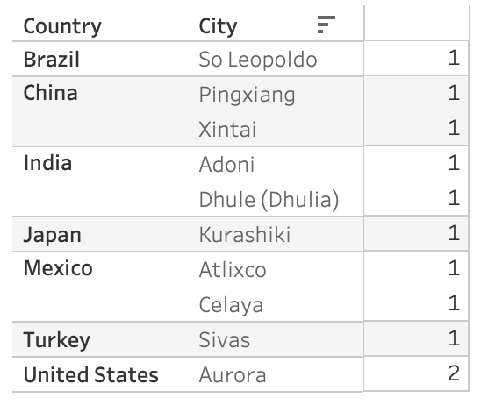
TOP 10 CITIES THAT ARE WITHIN THE TOP 10 COUNTRIES

Slide 8

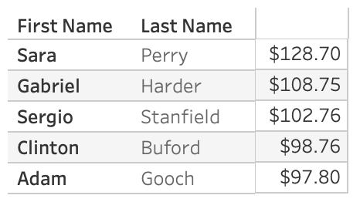
TOP 5 CUSTOMERS BY TOTAL PAYMENT
$
Average of Top 5: $107.34

Slide 9
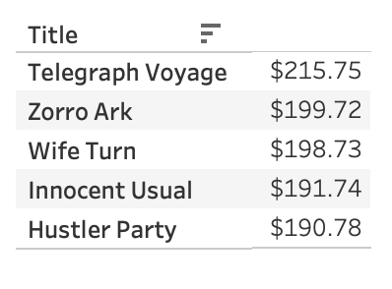
Which movies contributed the most to revenue gain?

Slide 10
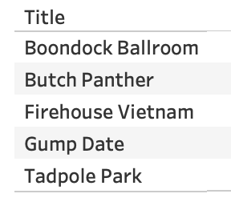
Which movies contributed the least to revenue gain?
There are 42 movies that had no values for revenue

Slide 11
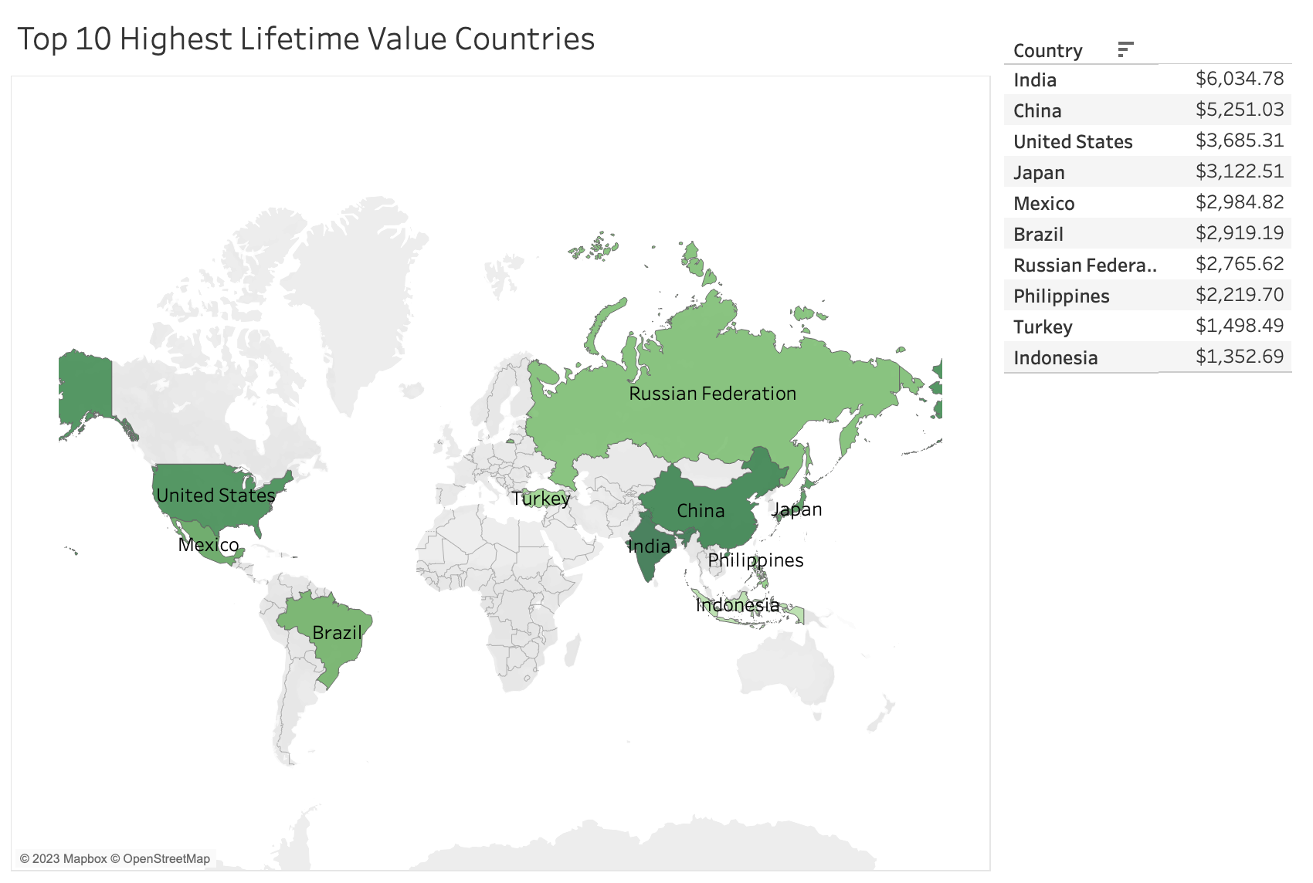

Slide 12
Link To Tableau Workbooks Below
Top 10 Countries
High Value Countries

